Slide 1

Activity 1: Crack the Code
In this activity, you will:
Understanding how the Caesar Cipher works.
Using a Python script to encrypt and decrypt messages.
Modifying the script to brute-force decrypt a message by testing all possible shifts.
Uncovering a hidden URL or secret word to complete the challenge.
Notes:
https://studio.code.org/s/hoc-encryption/lessons/1/levels/1
Caesar Cipher Wheel

Slide 2
Crack the Code
Access the GitHub repository and wait for the lecturer to go through the scripts.
Part 1:
Use Replit for Python scripting (https://replit.com/)
Run “EncryptionExample” script to see how encryption works with a known shift.
Modify the shift value to test other possibilities manually.
Part 2:
Can you modify the script to decrypt an encrypted message?
Try to decrypt a message by brute-forcing all possible shifts (0–25).
Hint: Update the script to loop through all shifts.

Slide 3
Extension Task:
Add input functionality so the script can encrypt/decrypt custom messages.
Example:
text = input("Enter your message: ")
shift = int(input("Enter the shift value: "))
print("Encrypted message:", caesar_cipher(text, shift))
Discuss why Caesar Cipher is insecure (e.g., brute-forcing is too easy).
Notes:
Time: about 10 minutes

Slide 4
Reflection and Discussion
Questions to Discuss:
How does encryption protect information?
Why is the Caesar Cipher no longer secure?
What modern encryption methods are used today?
Key Points:
Encryption is essential for data security.
Simpler ciphers are vulnerable to brute force, emphasizing the need for strong algorithms like AES.
Notes:
Time: about 10 minutes
Note to staff:
Monitor progress and help students modify the script if they’re stuck.
Emphasize experimentation—encourage students to try different inputs and shifts.
Use the activity to introduce the concept of "frequency analysis" if time permits (how often letters like E or T appear in English).

Slide 5
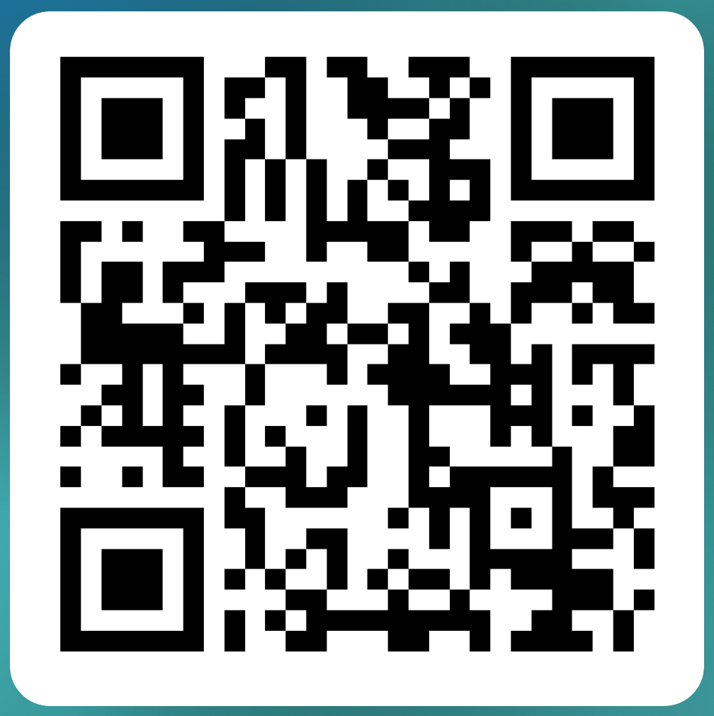
Any question?
Please participate in a quick survey
bit.ly/csltueventsurvey
(5 min)

